Slide 1

Persephone
Have you seen her?
Mrs. Patricia Ramsey
Mrs. Campbell
May 2013

Slide 2
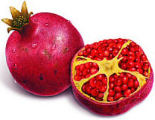
Background
Persephone is Demeter’s daughter.
She is the Greek goddess of Innocence, Receptivity and Queen of the Underworld.
She also represents youthfulness and innocence.
Her symbol is the pomegranate.

Slide 3
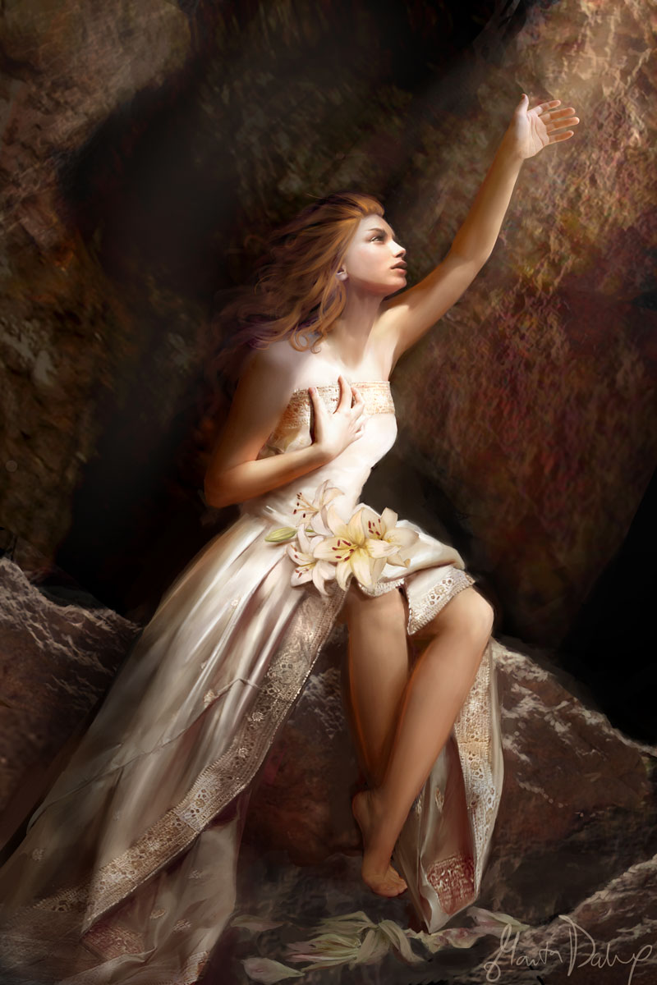
Daughter of Demeter
Demeter, Persephone’s mother, was the goddess of the harvest, agriculture, and grain.
She displayed her moods through feast and famine.

Slide 4
Queen of the Underworld
When Persephone was younger, Hades set a the trap of an irresistible cosmic flower that he could use to capture her.
After she picked the flower, the earth opened up and Hades took her.
He kept her there as his queen, and almost no one knew what had happened to her.

Slide 5
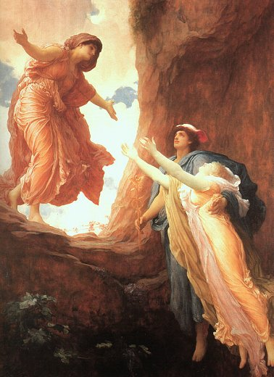
Demeter demands her to be returned
Hekate and Helios were the only ones who had seen and heard what happened to Persephone. They told the story to Demeter.
After finding out that Hades had taken her daughter, Demeter got Zeus to help her get her daughter back.
They came to an agreement where Demeter would get her daughter 2/3 of the year and Hades would keep her for the other 1/3.

Slide 6

Seasons
It used to be that there was only one continuous season with good and prospering crops.
But, after the deal was made with Hades, Demeter deprived the earth of crops for the 1/3 of the year that her daughter was kept away from her, changing the seasons into sections, rather than just one continuous one.

Slide 7
Works Cited
Bryant, Megan E. Mythlopedia: She’s All That! Scholastic, 2010. pp. 100-103.
Ledbetter, Christopher. “The Oracle and the Muse.” http://caenus.blogspot.com/
2011/04/splendor-of-persephone-artful- thursday.html
This is the page where you will put all of your sources.

Slide 8
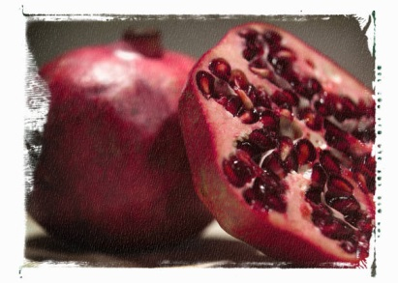
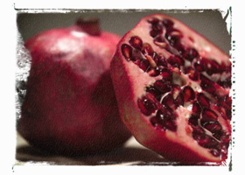
Persephone’s Pomegranates, Inc.
Owner: Persephone
Address: 100 Devil Drive, Hades, The Underworld
Phone: 1-800-get-me-mom
Email: helpme@greekgoddess.net
Only Available from June 1st until August 31st
Stay young…eat a pomegranate today!

Slide 9
Persephone’s Pomegranates, Inc.
Logo
Product
Owner: Persephone
Address: 100 Devil Drive, Hades, The Underworld
Phone: 1-800-get-me-mom
Email: helpme@greekgoddess.net
Only Available from June 1st until August 31st
Stay young…eat a pomegranate today!

