Slide 1
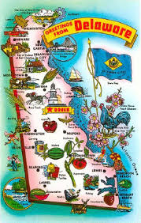
Delaware
Patricia Ramsey
Mary Mawyer
March 2014

Slide 2
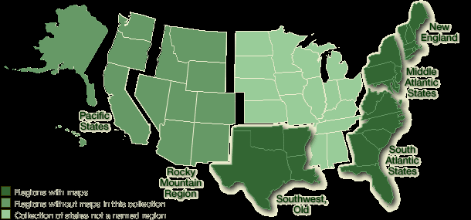
Region
Delaware is located in the mid Atlantic region of the United States. Tiny Delaware, the second smallest state, is only 100 miles long and 30 miles wide.

Slide 3
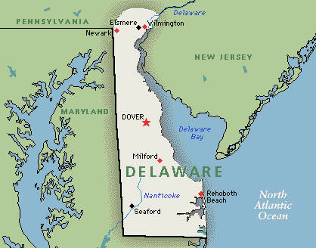
Capital: Dover
Dover is the capital of Delaware.

Slide 4
History
Delaware became a state on December 7, 1787. It was the first state to ratify the United States Constitution. Delaware was named after Sir Thomas West (Lord de la Warr), the Virginia Company's first governor.

Slide 5
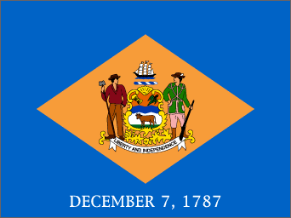
Flag

Slide 6
Geography
Delaware is bordered by Pennsylvania, Maryland, and New Jersey. It is also bordered by the Delaware Bay and the Atlantic Ocean.

Slide 7

Agriculture
Corn is Delaware’s number one crop, it is grown on 2/5 of the cultivated land; soybeans are second.
• Apples are Delaware’s leading fruit crop.
• Broilers are Delaware’s most valuable farm product.
• Livestock and related products account for 70% of Delaware’s farm income.
• Southwestern Delaware raises the most pigs.

Slide 8
Industry
Delaware is known for its chemical industry. The major economic enterprise is manufacturing, especially chemicals. Wilmington boasts of being the chemical capital of the world.

Slide 9

Governor
Democrat Jack Markell is the current governor of Delaware. He was sworn in as governor in 2008.

Slide 10

Sports Teams
University of Delware: The Blue Hens

Slide 11
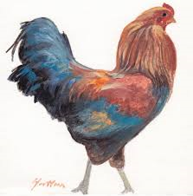
State Bird
Blue Hen

Slide 12

State Flower
Peach Blossom

Slide 13
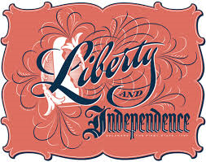
State Motto
Liberty and Independence

Slide 14
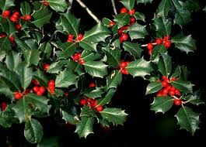
State Tree
American Holly

Slide 15

State Song
“Our Delaware”

Slide 16
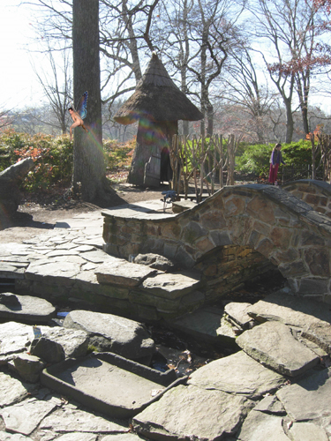
Places to Visit
Winterthur Museum

Slide 17
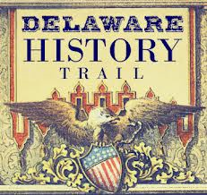
Places to Visit
Delaware, the state that started the nation welcomes you to explore the Delaware History Trail. This jouney will take you on a tour of the First State’s historical treasures. The trail highlights significant locations statewide that have impacted the history of Delaware and our nation.

Slide 18
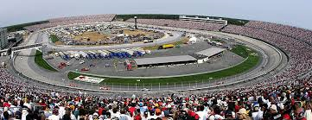
Places to Visit
Experience the thrill of the race at the Dover International Speedway! Twice a year, NASCAR race weekend comes to Delaware, where drivers take on the high banking turns of the Monster Mile.

Slide 19
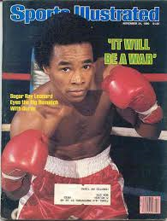
Famous People
Sugar Ray Leonard was the first boxer to earn more than $100 million.

Slide 20
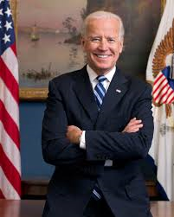
Famous People
Joe Biden: Our Vice President

Slide 21
Population/Rank
897,934 in 2010. Delaware ranks 45th in the nation in population.

Slide 22
Largest Cities
Wilmington is the largest city in the state of Delaware. It has a population of 70,851. Dover: Population 36,047
Newark: 31,454

Slide 23
Works Cited
Clendaniel, Douglas. “Delaware.” Compton’s. 2010.
“State of Delaware.” Delaware. Web. 3/27/2014. <http://www.delaware.gov/>.
World Almanac for Kids 2011. New York: World Almanac, 2011.

